Slide 1
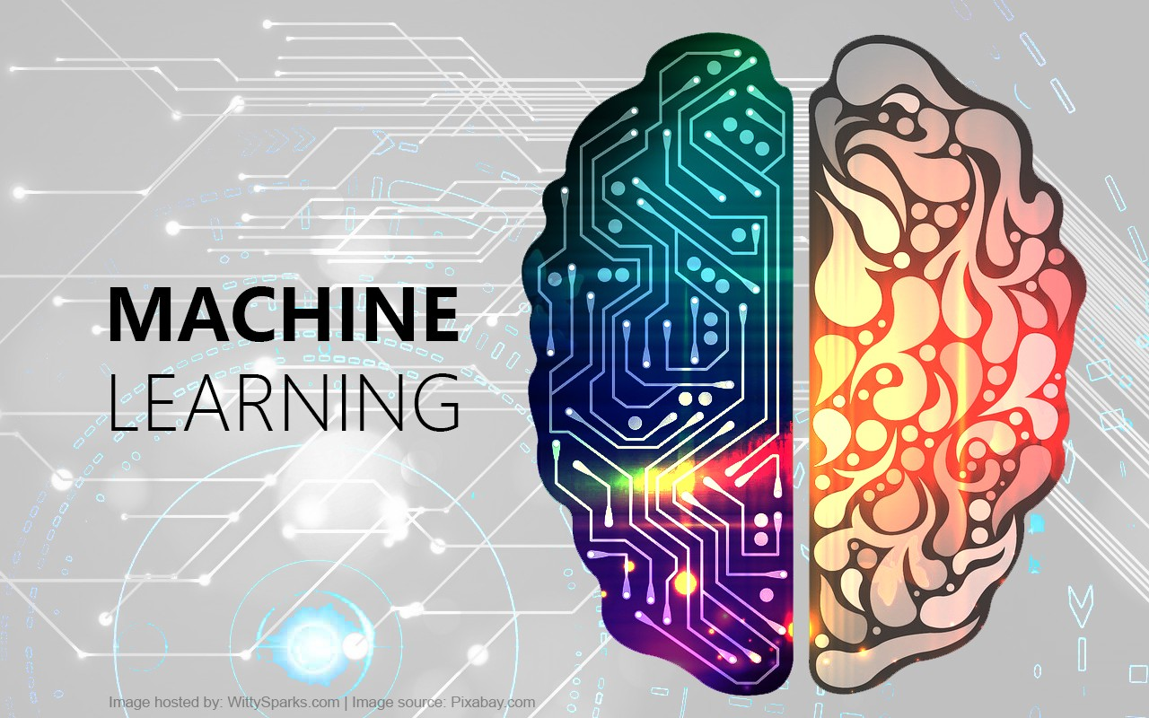

Slide 2

What is Machine Learning ?

Slide 3
Machine Learning is a technique to implement AI that can learn from the data by themselves without being explicitly programmed.

Slide 4
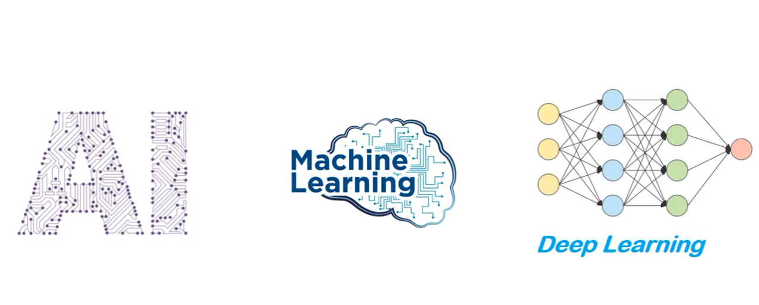

Slide 5
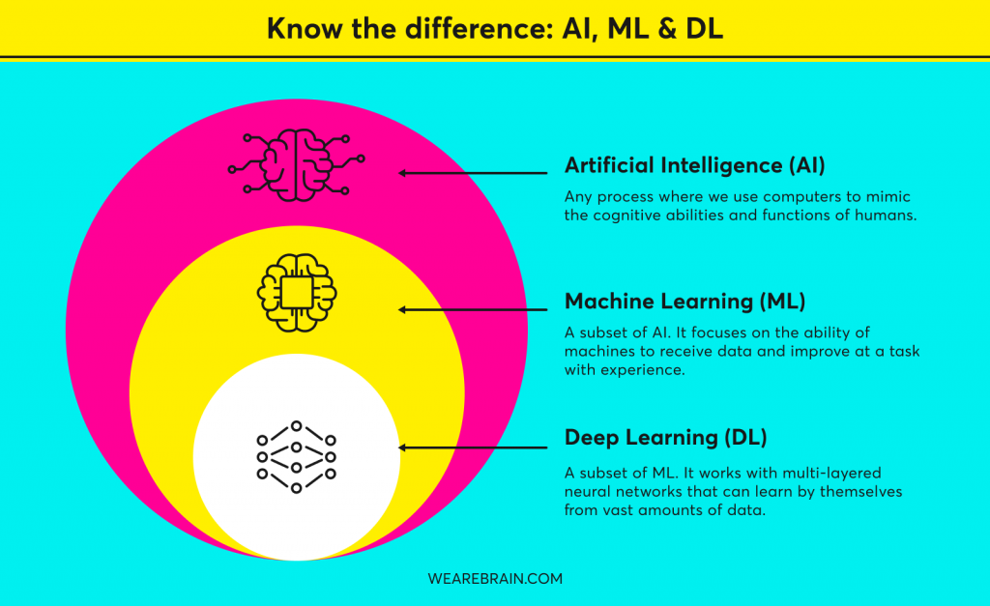

Slide 6
What is Artificial Intelligence ?
Artificial Intelligence
is a branch of computer
science that is concerned
with building smart &
intelligent Machines.

Slide 7
Non-Intelligence Machines vs Intelligence Machines

Slide 8


Non-Intelligence Machines

Slide 9
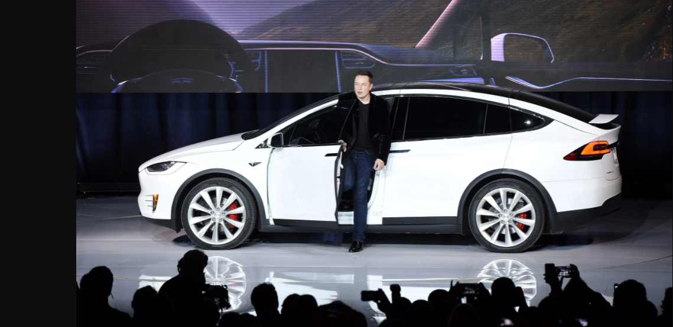

Intelligence Machines

Slide 10


Machine Learning
Machine Learning is a technique to implement AI that can learn from the data by themselves without being explicitly programmed.

Slide 11
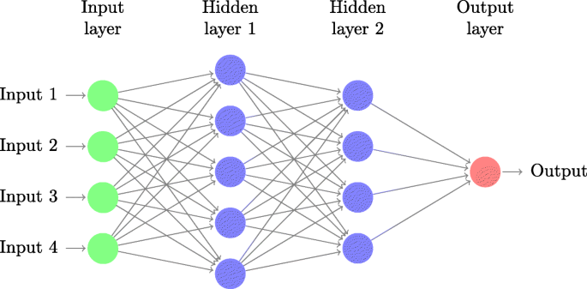
Deep Learning
Deep Learning is a subfield of Machine Learning that uses Artificial Neural Networks to learn from the data.

Slide 12
Types of Machine Learning
1. Supervised Learning
2. Unsupervised Learning
3. Reinforcement Learning

Slide 13
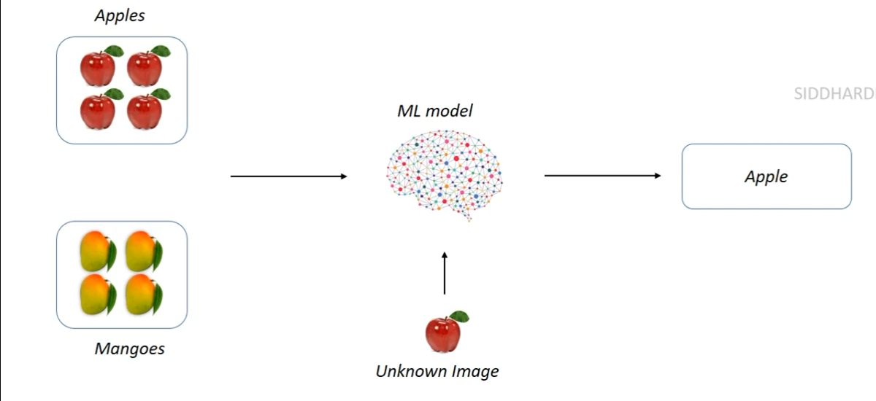
Supervised Learning
In Supervised Learning ,the Machine Learning algorithm learns from Labeled Data .

Slide 14
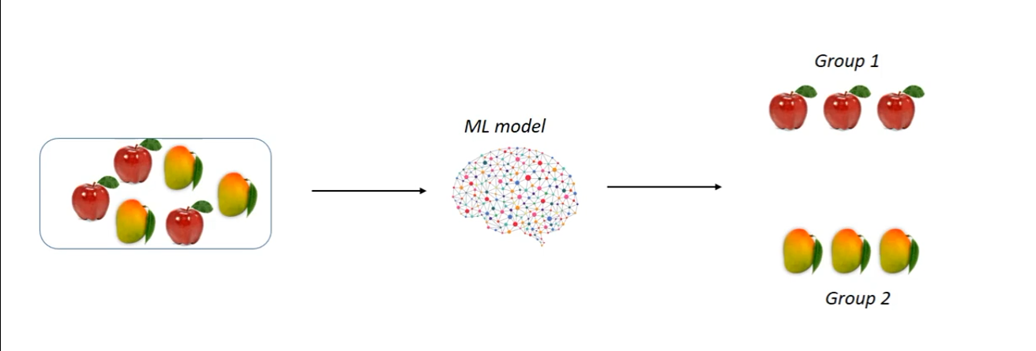
Unsupervised Learning
In Unsupervised Learning ,the Machine Learning algorithm learns from Unlabeled Data .

Slide 15
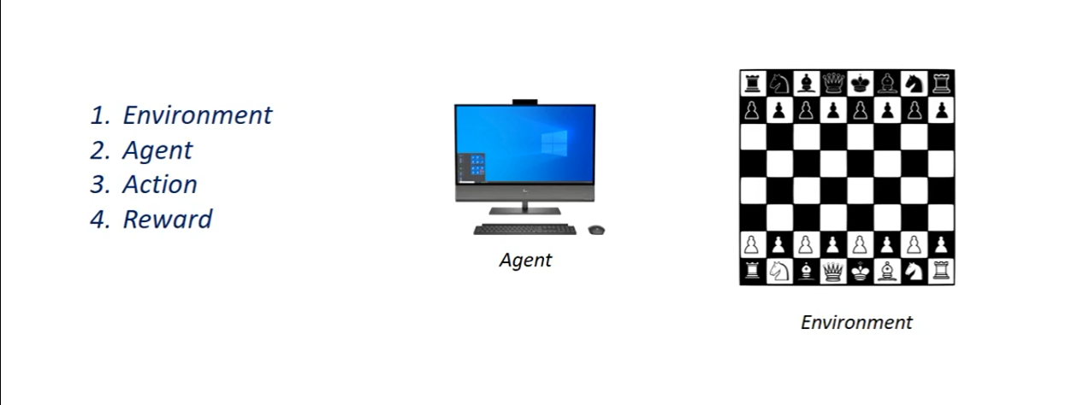
Reinforcement Learning
Reinforcement Learning is an area of Machine Learning concerned with how intelligent agents take actions in an environment to maximize its rewards.

Slide 17
Thank you!

